Slide 1

Designed big data
Survey Data Analysis 2022
Bella Struminskaya & Peter Lugtig
b.struminskaya@uu.nl http://bellastrum.com/
Copyright Bella Struminskaya, Vera Toepoel, Peter Lugtig

Slide 2
Outline
Non-probability inference competition
Some benefits of big data for inference
Often non-probability
Mixing surveys and big data
Calibration
Designed big data
Data donation and willingness (Bella Struninskaya)

Slide 3
Results last weeks’ competition
Kirsten: Raking on:
Gender, education, Gun_owner, division, vote in 2016, religiosity, military trust, follow the government, born in USA, registered voter, party support
Zahroh: poststratification on:
Voting in 2014, party support
Raw results: 12.9% off election result
Zahroh ‘wins’, with being 8.4% after poststratification
Kirsten: 8.5%

Slide 4
Organic / big / found data sources:
Very often non-probability
(see eg. Meng, 2018)
Transaction data: describe an event, e.g., a person interacts with a business or a government entity
Social media data: scraped from social networks, blogs, web searches etc. E.g., Google Flu Trends
Internet of Things (IoT) data: data collected from interconnected devices such as autos, household appliances, security cameras, wearable sensors, GPS locators etc. E.g., gathering data on movement of people and things, electricity use (lifestyle & rhythms of daily life)

Slide 5
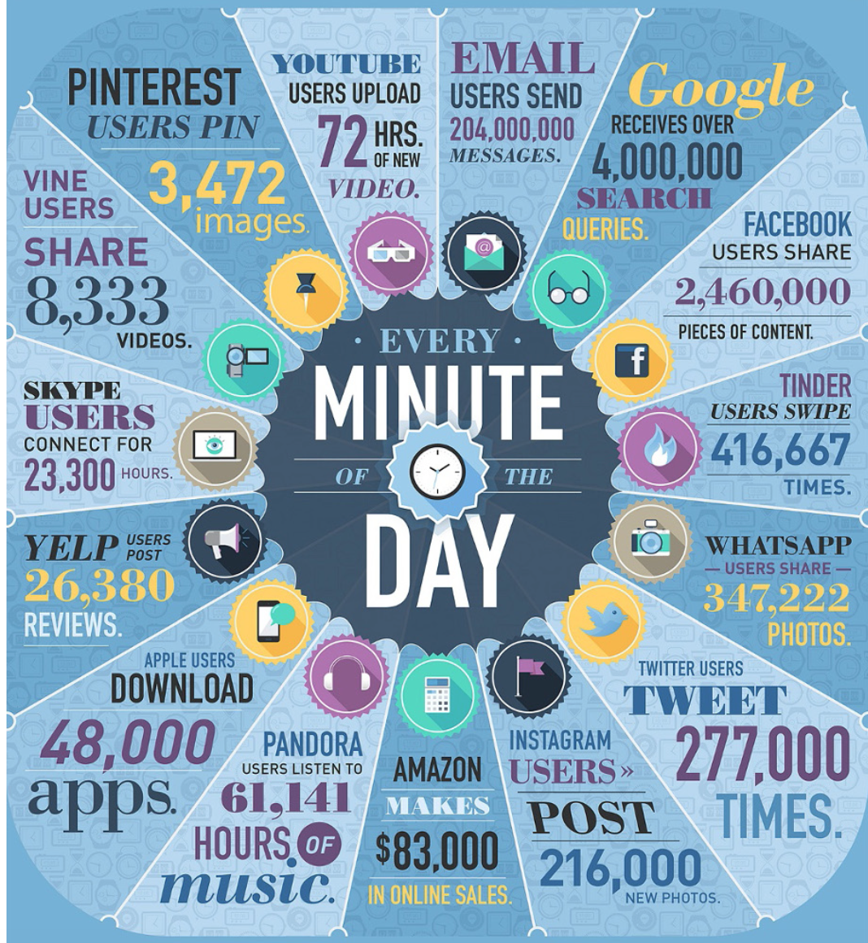
Characteristics of big data:
Volume
Variety ((no) structure)
Velocity
Veracity (accuracy)
Variability (differences in meanings across sources)
Value
Visualization
Source: Baker 2017, Infographic: James 2014

Slide 6
Types of big data
Types of big data
Administrative data – provided by persons or organizations for regulatory or other government activities
Transaction data – generated as an automatic byproduct of transaction and activities (e.g., credit card data, traffic flow data)
Social media data – created by people with the express purpose of sharing with (some) others
Sensor data – GPS, accelerometers, heartbeat

Slide 7
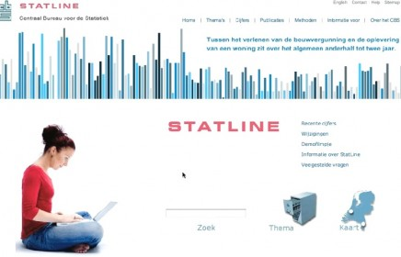
Administrative data
Statistics Netherlands
Business administration
Market data
Pros
Accuracy (?)
Costs (?)
Speed (?)
Cons
Missing data?
Reliability: data collection and definitions the same?
Validity:
Are they measuring what YOU want to measure?
Do you KNOW the definitions of variables? Are they yours?

Slide 8
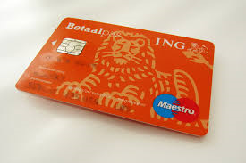
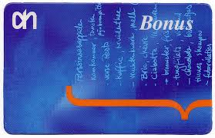
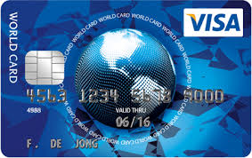
Transaction data
-Data Availability? Often proprietary! A key strength of surveys is public access to data, permitting replication and reanalysis
-Not everyone uses cards!
-Knowing what people buy is not the same as understanding WHY they buy!

Slide 9

Social Media Data
Selection bias: “haves” versus “have-nots”
Not everyone uses social media!
Need to distinguish between producers and users of users of social media – small part of online population actively tweets
Measurement bias
Self-presentation bias: Impression management is a key element of social media
The average Facebook user has MANY “friends”

Slide 10
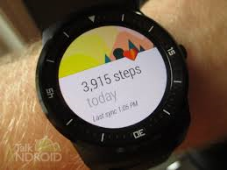
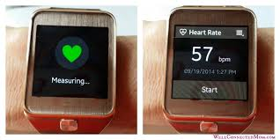
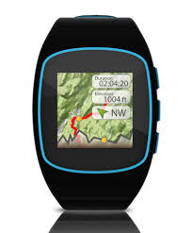
Sensor data
-Not everyone allows you to track them:
47% share their GPS coordinates (Struminskaya et al. 2018)
-some type of activities are difficult to measure
-thresholds for intensity are arbitrary

Slide 11
Surveys & Big data
“Designed” data: Collected for the research purposes Researcher control over content Large number of covariates Detailed documentation of the data generating process | “Organic” data: Collected for purposes other than research No control over content Limited number of covariates No / little documentation Access issues (Missingness & coverage)
High nonresponse Small N Measurement error (recall, social desirability) | Large N No measurement error due to self-report
(based on Baker 2018, Groves 2011, Sakshaug 2015, Salganik 2018)

Slide 12
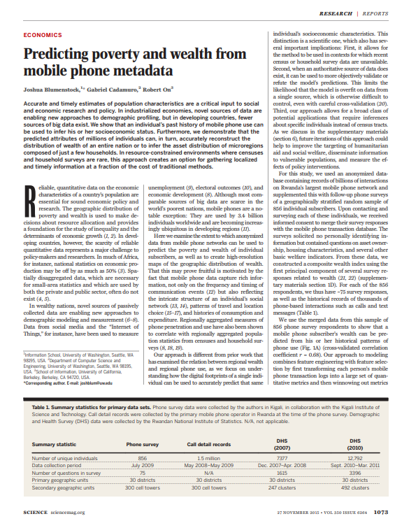
Can anonymized data from mobile phone networks predict poverty and wealth?
Anonymized call records (1.5 mil)
Telephone survey (n=856)
(Blumenstock et al. 2015)
Notes:
For us, difficult to imagine: In much of Africa, national statistics on economic production may be off by as much as 50%, small-area statistics often do not exist
Mobile phone use is very high in developing nations
DHS conducted by national institute of statistics in Rwanda

Slide 13
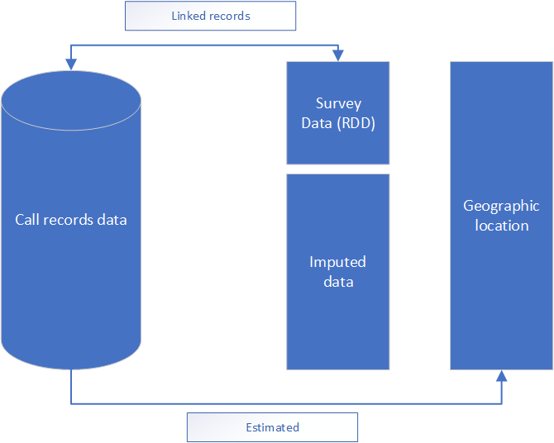
Can anonymized data from mobile phone networks predict poverty and wealth?
Call activity
SMS activity
International communications
Network structure
Movement
etc.

Slide 14
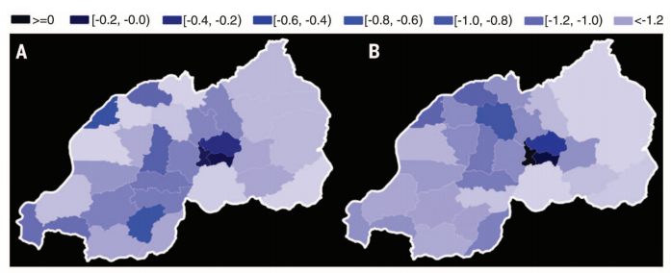
Can anonymized data from mobile phone networks predict poverty and wealth?
Anonymized call records (1.5 mil)
Telephone survey (n=856)
‘Gold standard’ f2f Demographic and Health Survey (n=12792)
Composite wealth index: A – predicted from call data, B – actual from DHS, r=0.79
(Blumenstock et al. 2015)
Notes:
For us, difficult to imagine: In much of Africa, national statistics on economic production may be off by as much as 50%, small-area statistics often do not exist
Mobile phone use is very high in developing nations
DHS conducted by national institute of statistics in Rwanda

Slide 15
Added value
High-resolution maps of poverty and wealth
Small area estimation: survey provided estimates on cluster level, call records much richer
Timely data
Costs (12,000 vs. 1 Mil)

Slide 16
Bostanci et al (2022) – source 1 :traffic sensors
Traffic sensors on Dutch roads
Number of cars/trucks passing by every minute
1440 measurements by day
Continuous data
Problem:
Lots of roads are missing

Slide 17
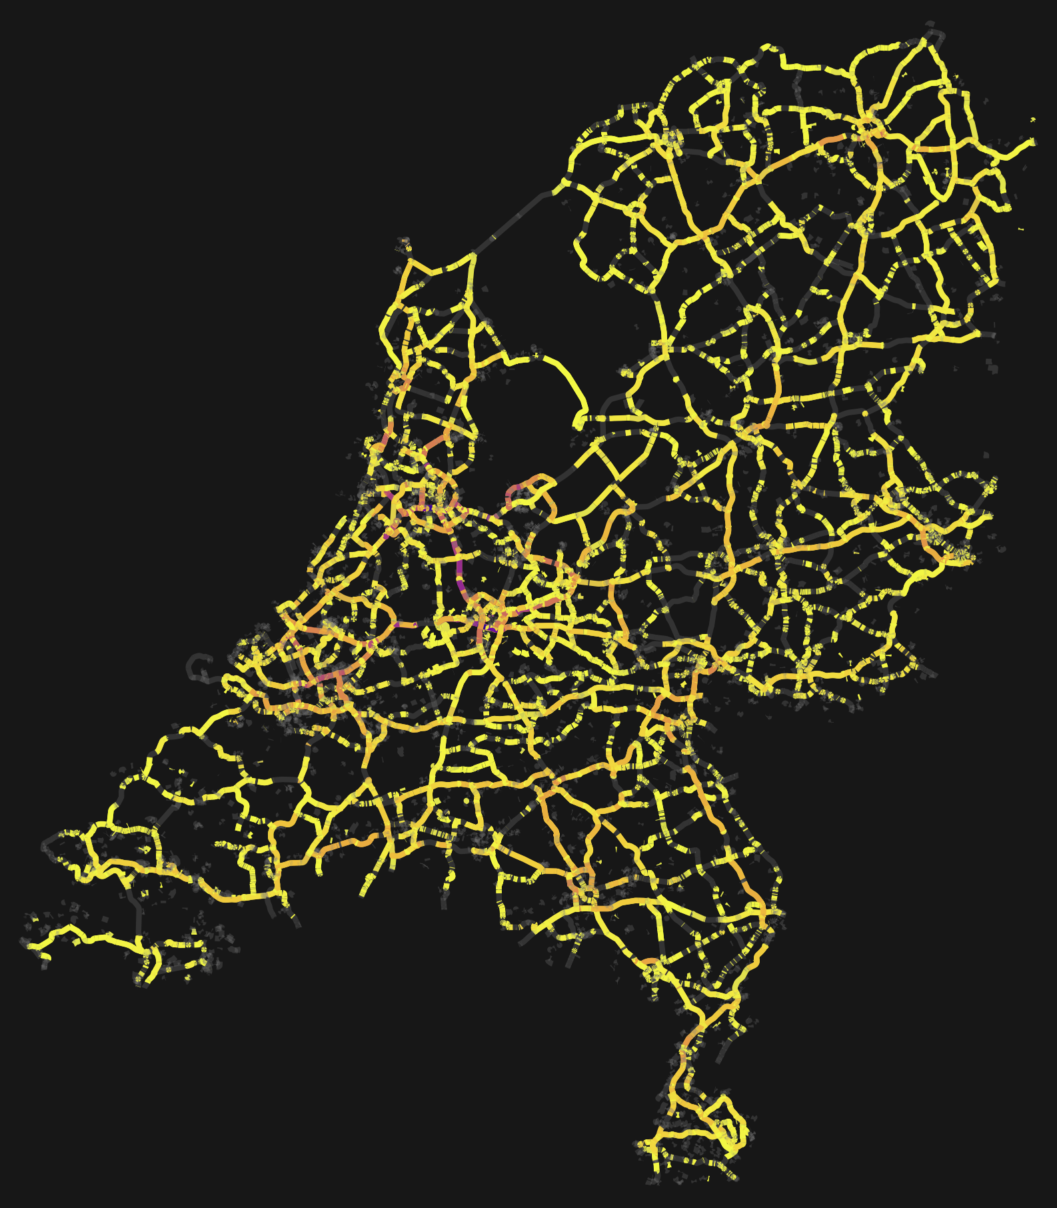
Bostanci –source 2 (admin data)
Uses admin data by CBS
~ 8 million people who have a job
Home and work address
Use trip planner to predict
Likelihood of traveling by car
Route traveled
3. Predict traffic intensity
Problem: are these data accurate?

Slide 18
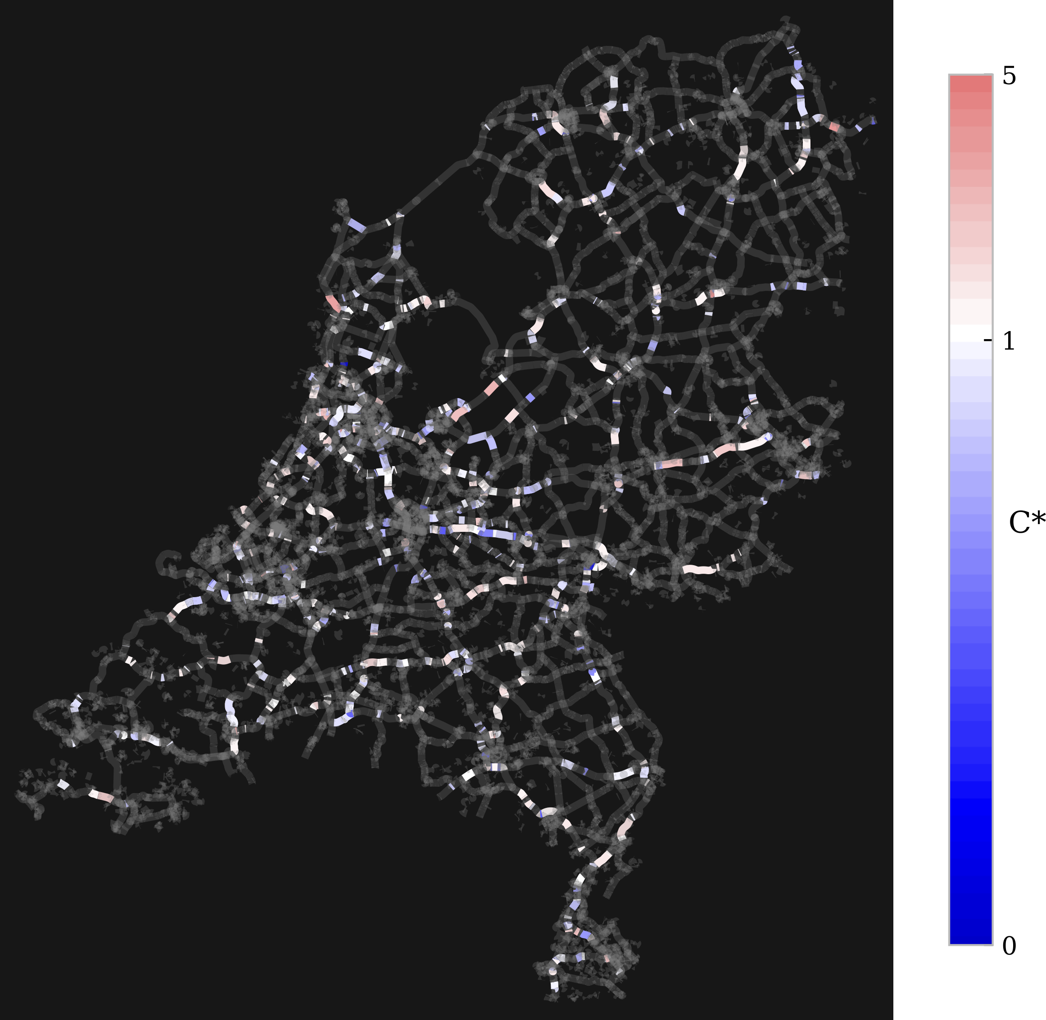
Bostanci – compare sources
Red: overestination in sensors
Blue: overestimation in admin data
Model does pretty well!
Allows us to identify problems in admin data
And to predict road traffic intensity for all roads in Netherlands

Slide 19
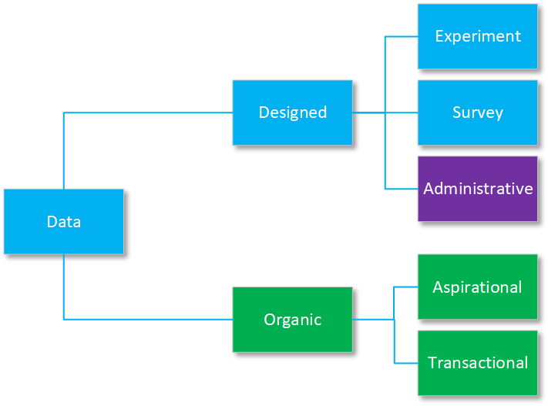
(Source: Kreuter 2018)
Notes:
Data are generated incidentally or purposively
Transactional: credit card data, GPS location
Aspirational: tweets or facebook status

Slide 20
(Source: Kreuter 2018)
Notes:
Data are generated incidentally or purposively
Transactional: credit card data, GPS location
Aspirational: tweets or facebook status

Slide 21
Bostanci (2022)
Calibration
Of two differenct data files
(Source: Kreuter 2018)
Notes:
Data are generated incidentally or purposively
Transactional: credit card data, GPS location
Aspirational: tweets or facebook status

Slide 22
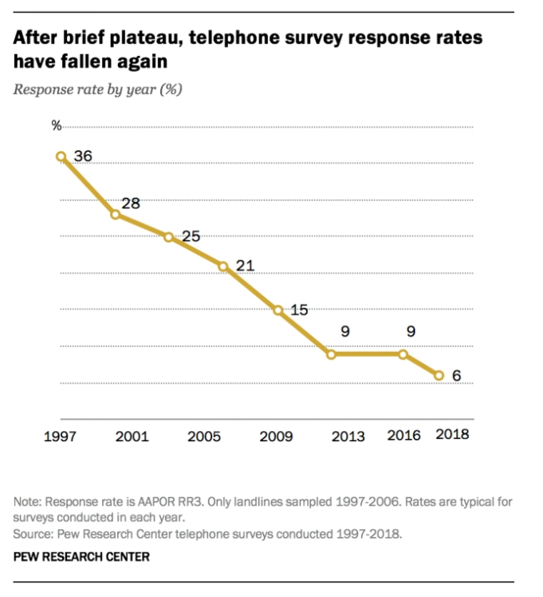
Decreasing response rates
https://www.pewresearch.org/fact-tank/2019/02/27/response-rates-in-telephone-surveys-have-resumed-their-decline/

Slide 23
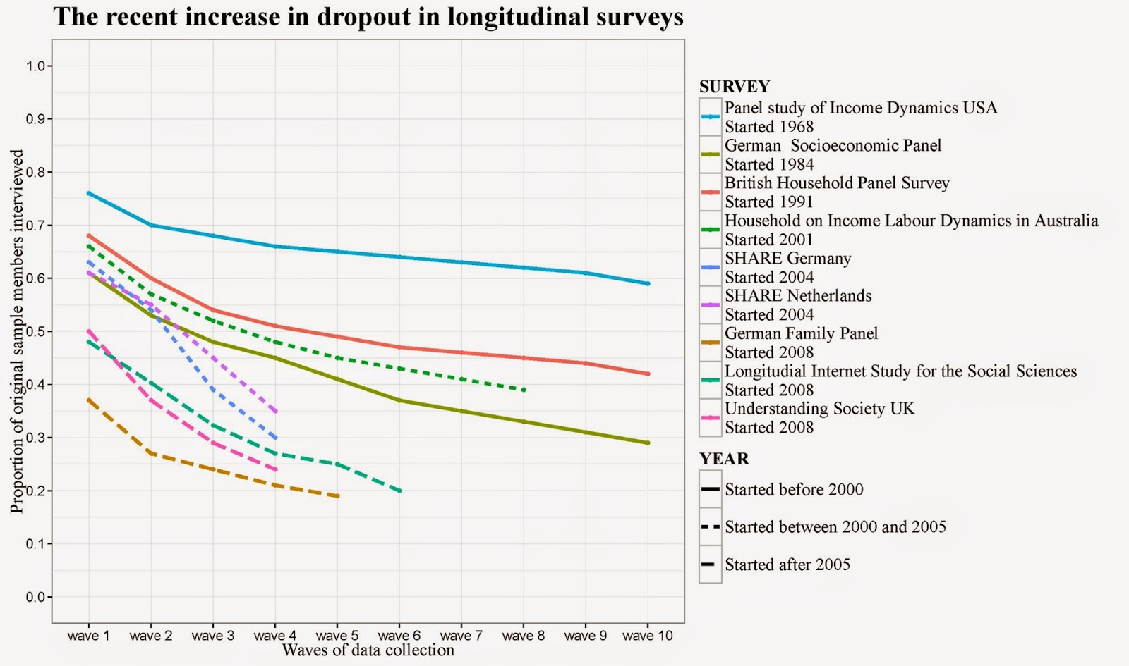
Cumulative nonresponse rates in large panel surveys (peterlugtig.com)

Slide 24
Willingness to collect sensor data
LISS Panel
November 2017
N= 3023
RR = 88.4%
(Struminskaya et al. forthcoming)

Slide 25
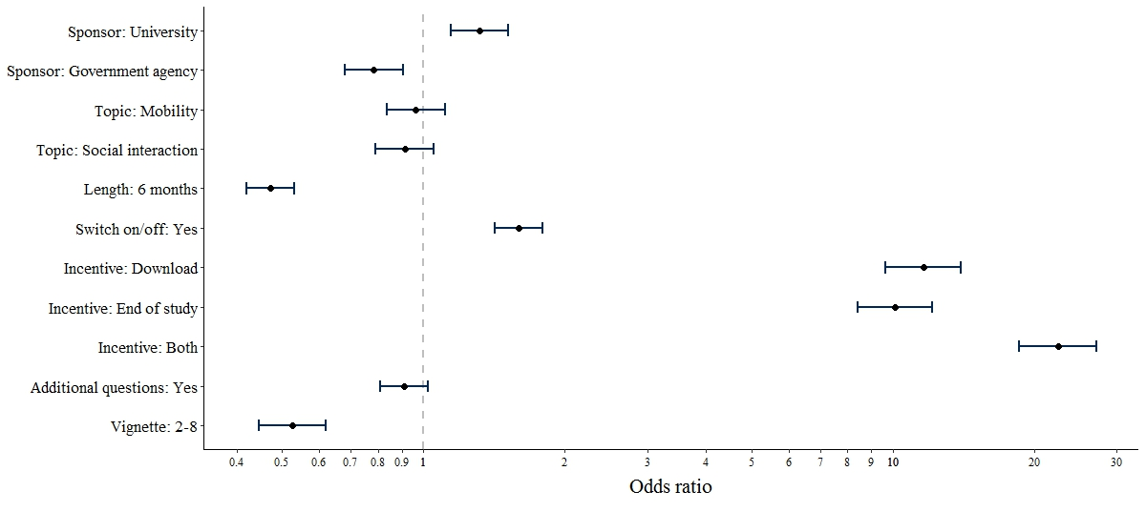
Willingness to download research app
Higher likelihood to be willing to participate with…
less concern with data security
higher trust in data collecting institutions
fewer perceived violations of privacy
more diverse smartphone activities
men
Odds ratios (points) with 95%-CI (lines) from multilevel logistic regression. DV: Dichotomized willingness to participate in passive mobile data collection. n=1,947 German smartphone users
Keusch et al. (2019)

Slide 26
Reasons (not) to participate
N=1947 German smartphone users
Keusch et al. (2019)

Slide 27
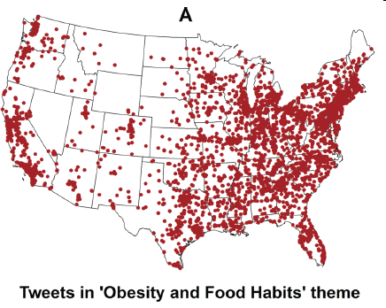
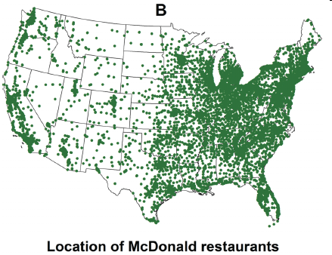
Few covariates: Obesity-Related Tweets and McDonalds Restaurants
Ghosh and Guha (2013) report a “strong correlation” between the two
Any alternative explanation come to mind?

Slide 28
Lack of stability
Technological speed:
What will Facebook or Twitter look like 5 or 10 years from now?
Mobile phones and sensors look very different now than 10 years ago
Big data may be good for measuring short term trends, but surveys may be better for longer-run measurement

Slide 29
Total Survey Error/Cornerstones of Survey Research (see Hox et al., 2008)
Coverage error
Sampling error
Specification
Nonresponse error
Measurement error

Slide 30
Total Survey Error/Cornerstones of Survey Research (see Hox et al., 2008)
Coverage error
Sampling error
Costs
Nonresponse error
Measurement error

Slide 31
Coverage in Big Data
Does the sampling frame include all units of the population?
 | High coverage? | Difference frame /population | Adjustment possible
Administrative data | yes, except for people that are not registered, e.g. illegals, homeless | ++ | Via snowball sample
Transaction data | Only those that pay with cards | + | Cash survey/observation
Social media data | Only those that are on social media | - | General population survey
Sensor data | Only those that wear sensors and allow you to track them | - | Nonresponse survey

Slide 32
Sampling in Big Data
No differences between big data and survey data
Is sampling necessary?
Often no additional costs for using census instead of sample
Often the unit of observation is not the individual
Transaction with transaction data
Verbal comment with social media data
Data capture point with sensor data
Recode into individual data
Dependent observations (many observations from few individuals)
Administrative data | ++
Transaction data | +
Social media data | --
Sensor data | --

Slide 33
Nonresponse in Big Data
Sampled but not collected
In principle, there is no non response in big data
Nonresponse error/bias is an important issue in surveys
Check
Compare big data to external data
Investigate internal variation within the data, e.g. difference in estimates by the number of verbal comments in social media data
Examination of adjustment estimates, where each adjustment contains different assumptions about nonresponse
Administrative data | ++
Transaction data | ++
Social media data | -
Sensor data | --

Slide 34
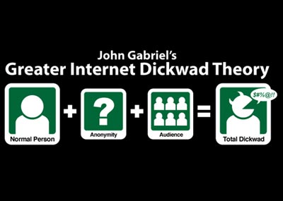
Measurement in Big Data
Is the data well-constructed, clear, and not leading or otherwise biasing? (AAPOR report survey quality, 2016)
Do people provide truthful data?
Were any respondents removed?

Slide 35
Measurement in Big Data
Is the data well-constructed, clear, and not leading or otherwise biasing? (AAPOR report survey quality, 2016)
Administrative data: do you know definitions? Are they the same as yours? Over time?
Transaction data: accurate?!
Social media data: Do people provide truthful data?
Sensor data:
Objective weight is about 1 kilo lower than reported weight (Koorenman & Scherpenzeel, 2014)
Automatic trip detection with sensors (Geurs et al., 2015): inaccurate with small trips, public transport trips not classified, unsuccessful mode detection in 25% of trips
Administrative data | -
Transaction data | ++
Social media data | --
Sensor data | -

Slide 36
Specification in Big Data
Formulating and answering research questions
The construct implied in the data differs from the intended construct that should be measured (validity)
Problems of wording, context, concepts
Ask what is essential for the research question
Check with qualitative techniques/interviews
Administrative data | +/-
Transaction data | +/-
Social media data | +/-
Sensor data | +/-

Slide 37
Costs in Big Data
Big data is already out there, so little costs involved!
Administrative data | ++
Transaction data | ++
Social media data | ++
Sensor data | +/-

Slide 38
Big data particularly useful for
Replace surveys/most survey questions
Travel
Budget
User groups/online communities
Increase survey data quality
Adding administrative data
Adding sensor data
Using social media data as a qualitative/pilot study
Transaction data? As an explanatory variable?

Slide 39
Passive data collection using smartphone sensors
Bella Struminskaya
with thanks to Florian Keusch
b.struminskaya@uu.nl
http://bellastrum.com/
Copyright: Struminskaya, Keusch

Slide 40
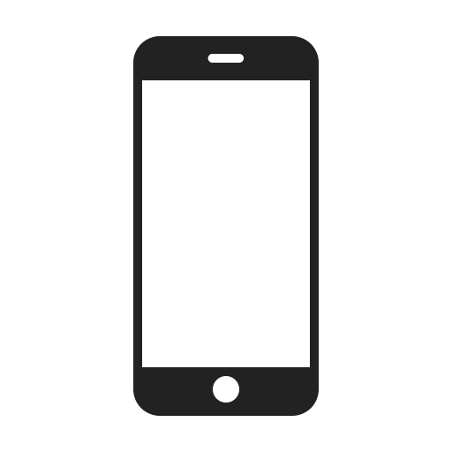
Native smartphone sensors
NFC
Bluetooth
Air humidity sensor
Thermometer
Proximity sensor
Wi-Fi
GPS
Microphone
Cellular network
Light sensor
Fingerprint sensor
Camera
Barometer
Compass
Accelerometer
Pedometer
Gyroscope
Notes:
Refer back to flipchart

Slide 41
Native smartphone sensors
Proximity
NFC
Bluetooth
Air humidity sensor
Thermometer
Location
Proximity sensor
Wi-Fi
GPS
Microphone
Cellular network
Light sensor
Ambience
Fingerprint sensor
Camera
Barometer
Compass
Accelerometer
Pedometer
Gyroscope
Physical activity
Notes:
Combinations of sensors to measure (not just one sensor)

Slide 42
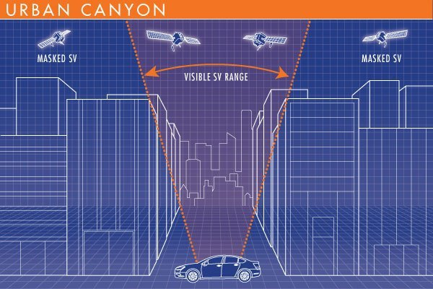
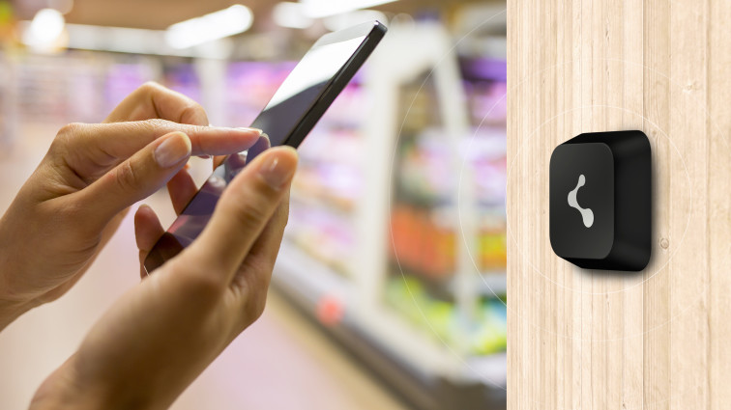
Location sensors
GPS
Coordinates in longitude & latitude
High accuracy (newest generation 30 cm)
Works without cell/Internet connection
Performs worse in ‘urban canyons’, indoors, and underground (pseudo accuracy!)
Can be battery-draining
Cellular network
Multilateration of radio signals between (several) cell towers
WiFi
Inferring location from Wi-Fi access points (AP)
Beacons
Bluetooth transmitters for indoors
Picture source: https://i2.wp.com/geoawesomeness.com/wp-content/uploads/2014/01/urbancanyon.jpg?fit=600%2C400&ssl=1,
https://locatify.com/wp-content/uploads/2015/03/beacon-wall-756x425.jpg
Notes:
Example with google maps and large radius

Slide 43
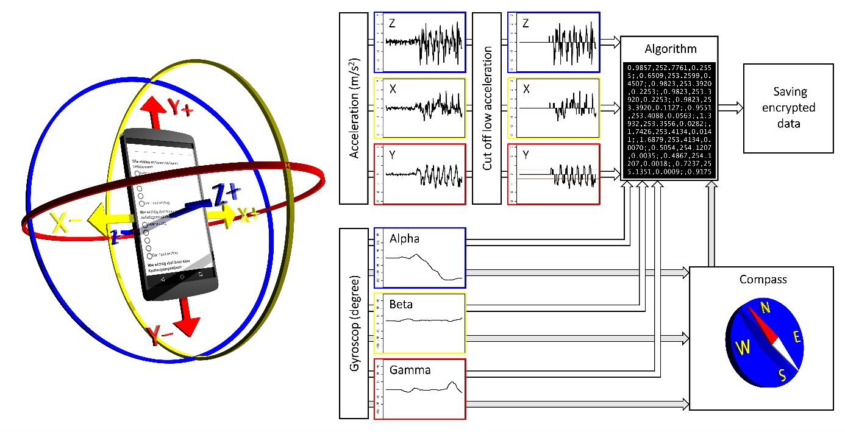
Physical activity sensors
Accelerometer
Gyroscope
Mangnetometer
Barometer
Pedometer
Source: Schlosser et al. (2019)
Notes:
Accelerometer: 3 axes, Gyroscope for tilting
Compass can be used to measure exact direction

Slide 44
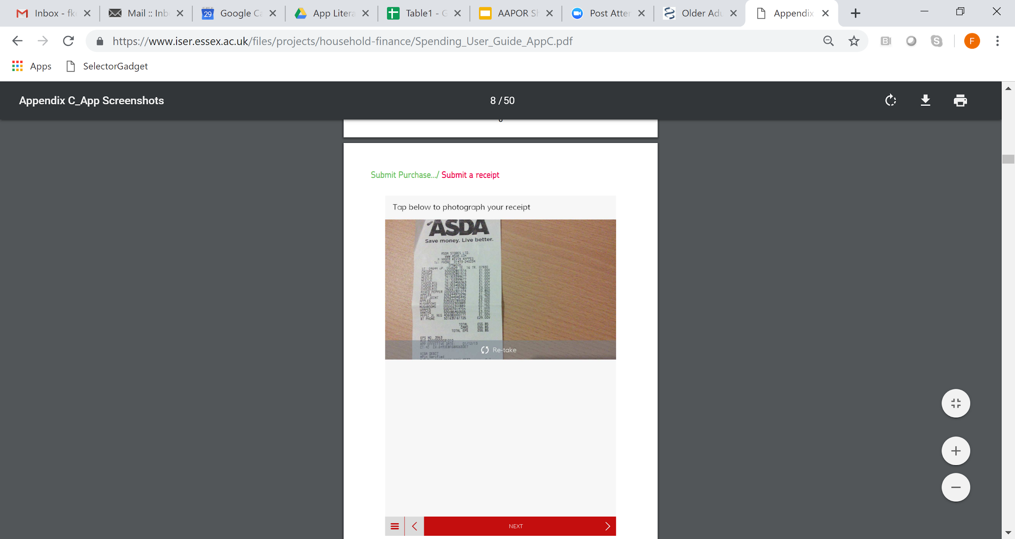
Ambience sensors, proximity sensors
Camera
photos, videos, scanning of bar codes
heart rate
linear distance
Microphone
active and passive (ambient noise) recording
Light sensor
e.g., identify idle state
Bluetooth
RFID
NFC
Source: Jäckle et al. (2018)

Slide 45
...a selection of research questions
How do environmental factors affect happiness? (MacKerron & Mourato 2013)
How do people interact in large social networks? (Stopczynski et al. 2014)
How much do households spend on goods and services? (Jäckle et al. 2019; Wenz et al. 2018)
What food and drinks do Americans acquire? (Yan et al. 2019)
How do people find work after prison? (Sugie 2018)
Does mental health of students change over the course of a term? (Wang et al. 2014)
How do people move around in everyday life? (McCool et al. in preparation)
What are the effects of unemployment? (Kreuter et al. 2018)
How do people’s home look like? (Ilic et al 2022)
Notes:
Not going into detail

Slide 46
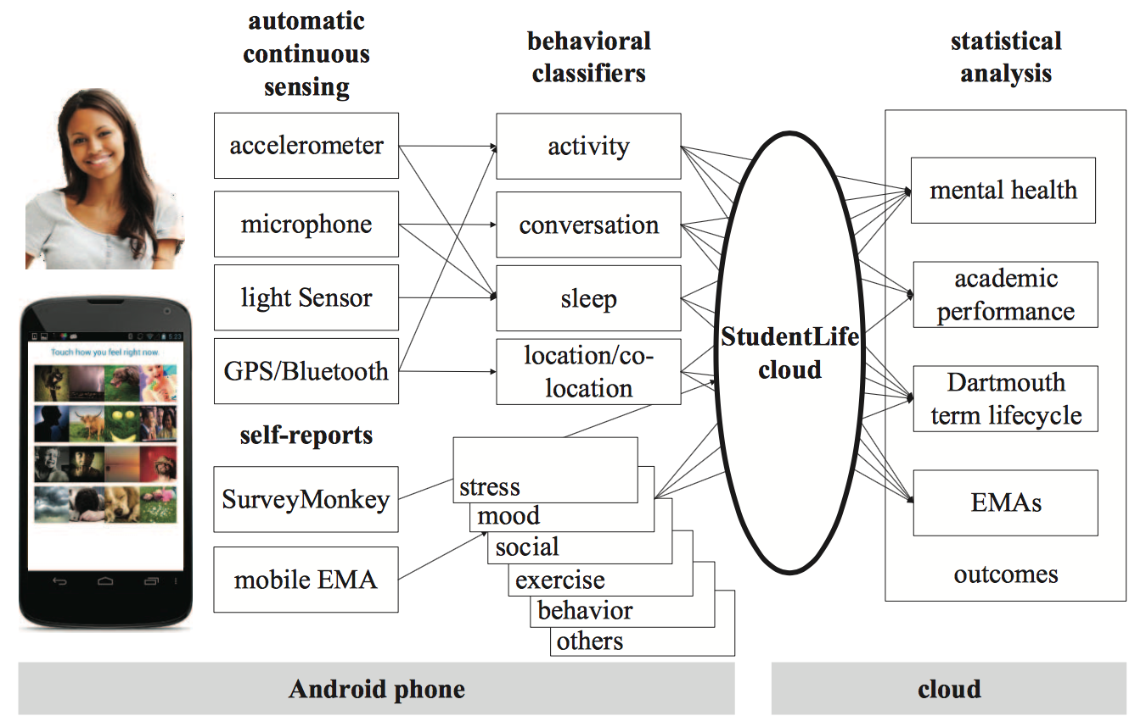
StudentLife App: Combining sensor data with self-reports
Wang et al. 2014

Slide 47
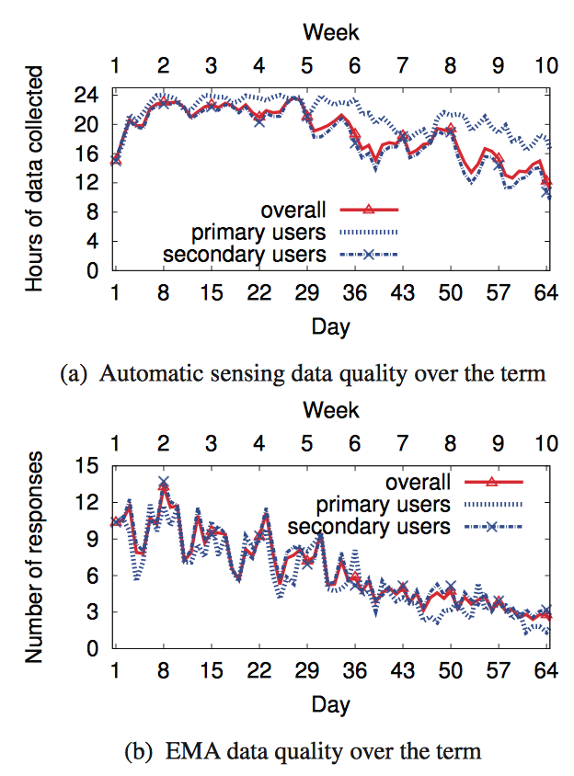
StudentLife Study Design
Participants: 48 students of Darmouth College (USA)
Duration: 10 weeks
Smartphones: Andriod provided to students (37) or own (11)
EMAs: about 8 times per day
Pre- and post-survey
Incentives: T-shirt and lottery
Feedback: none
Wang et al. 2014

Slide 48
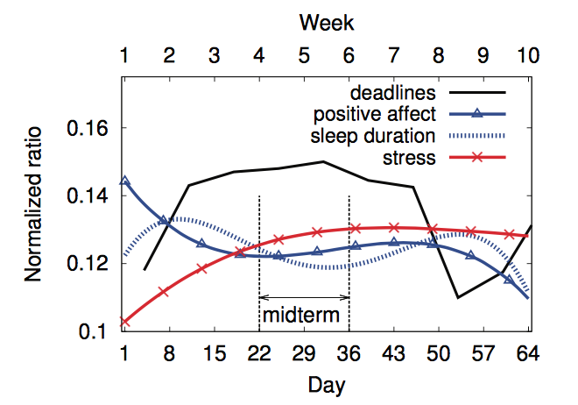
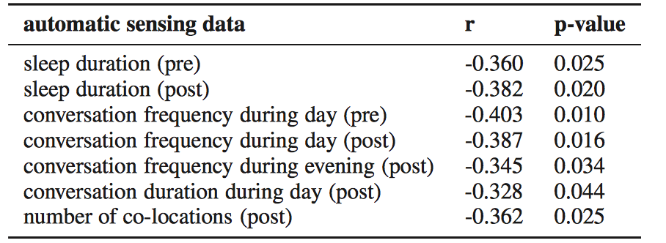
Correlation between self-report & sensor data
Depression & Automatic sensor data
EMA & Automatic sensor data (sleep)
Wang et al. 2014

Slide 49
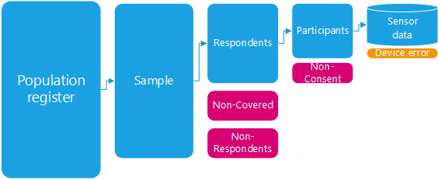
Introducing “design” to Big Data
Smartphone sensor data have many characteristics of Big Data
Large volume, high velocity, variety of data formats
Combining passive smartphone data collection with self-reports through surveys introduces “design” to Big Data
Notes:
Sensor data have many characteristics of big data but it is not found data, rather researcher has control over the content. TSE framework applies and errors can be quantified

Slide 50
How do people move around in everyday life? (McCool, Lugtig, and Schouten, under review)
Everyday mobility field test in the Dutch general population (Nov-Dec 2018)
Travel app of Statistics Netherlands (Android & iPhone)
Data collection for 7 days
N = 1,902
Sensing location per second (when moving) & per minute (when still):
GPS
Wi-Fi
Respondents eagerly provide additional information that helps understand travel behavior (label stops and motives for travel)
Notes:
Bella: sensing location when moving & when still, labeled stops
In-house developed app, different stop detection parameters were allocated at random, not suitable for older devices (iPhone 4, samsung S3 and earlier); half fresh respondents & half participated in an earlier web travel survey
25% of willing to use the app (comparable to typical web travel survey)

Slide 51
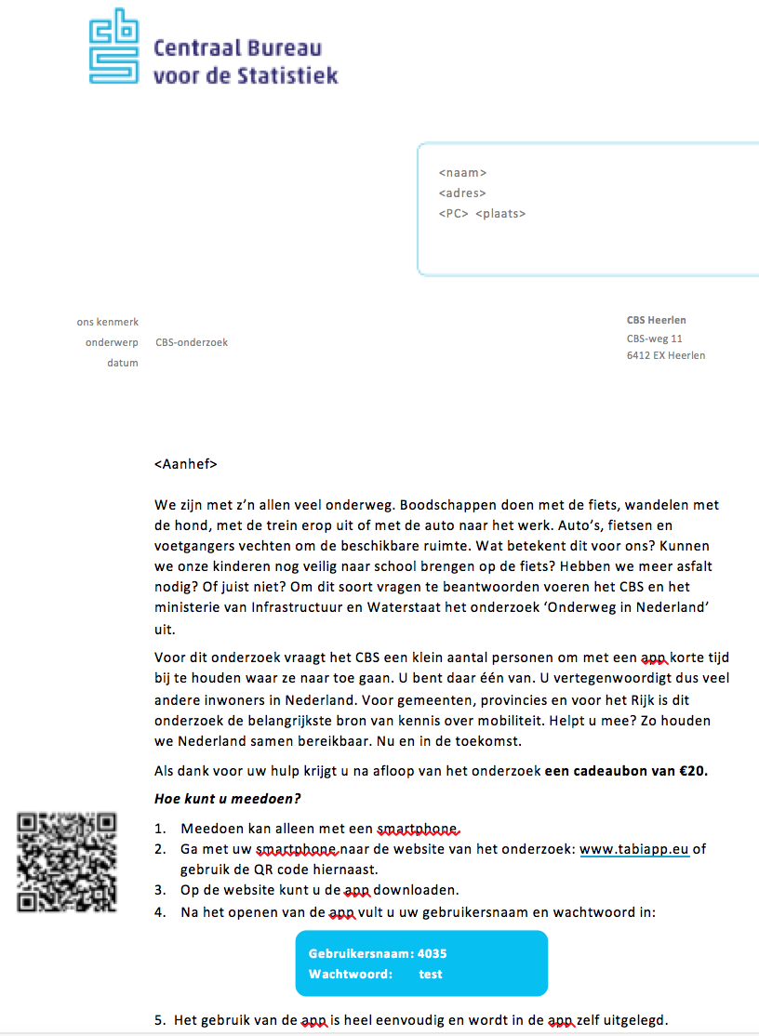
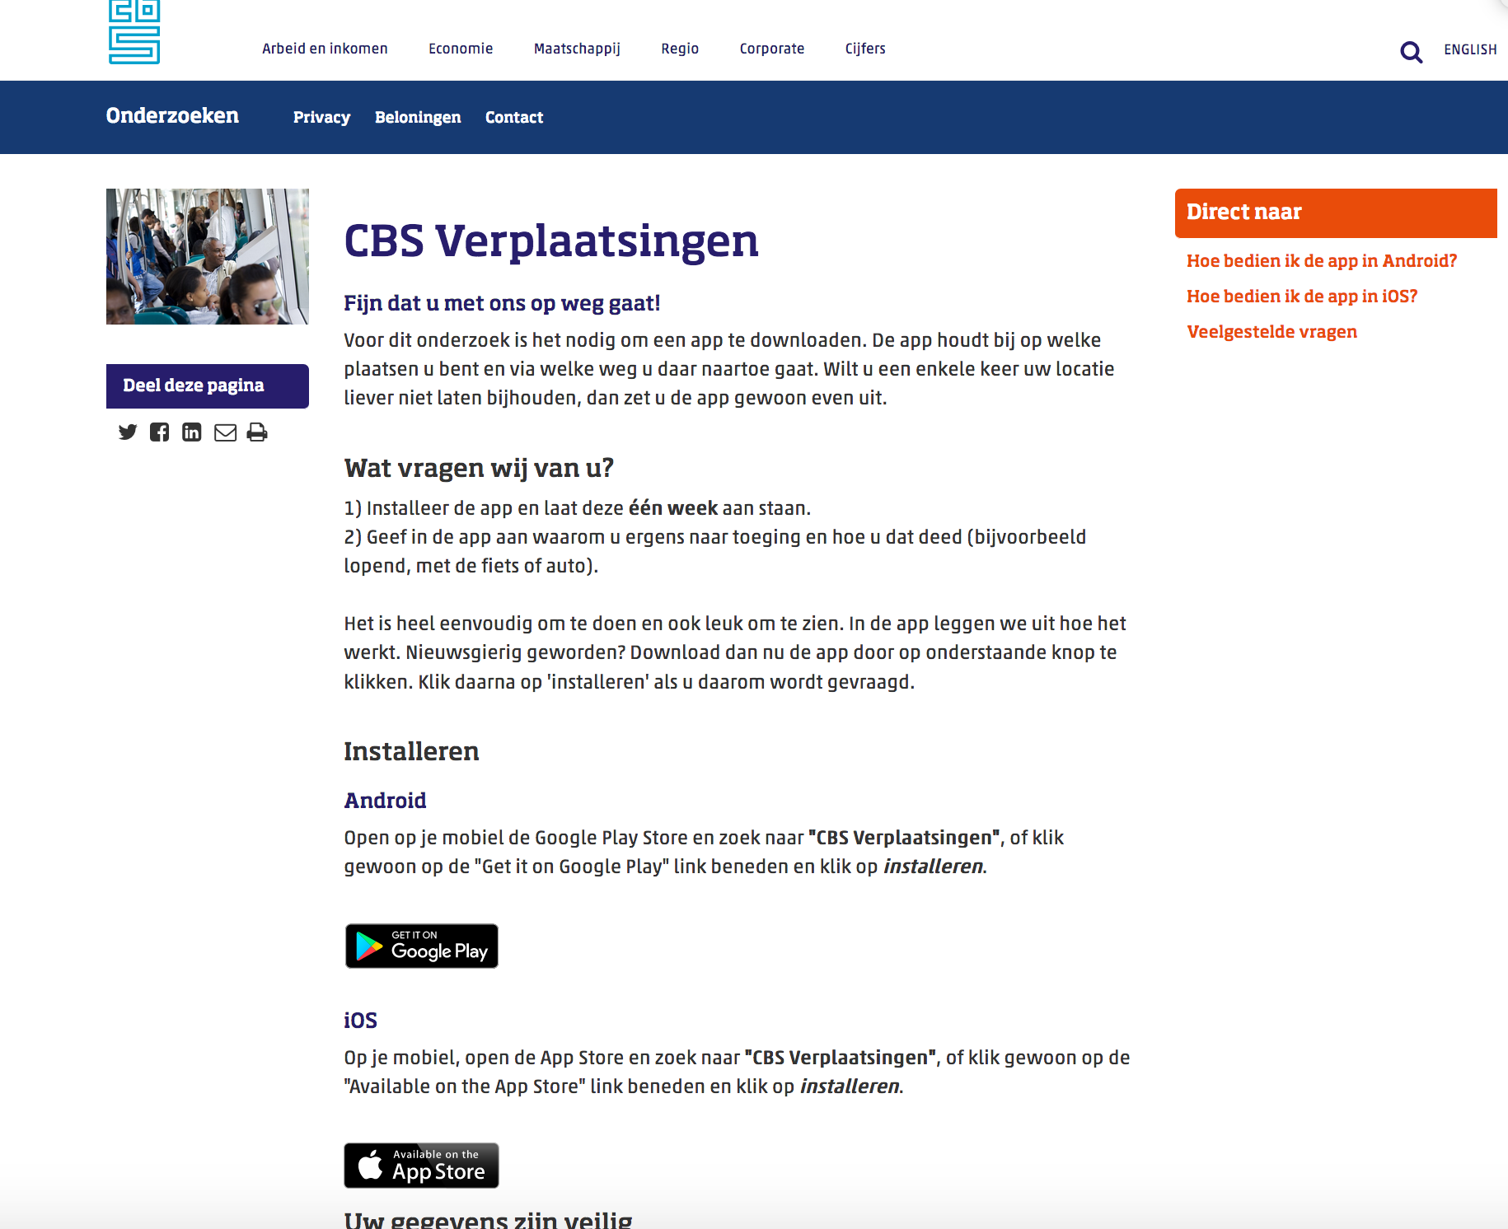
Recruitment (Lugtig et al. 2019)
Invitation letter
Website
App Download
Allow tracking
Notes:
Can be implemented in browser and in app. Here an example of browser consent

Slide 52
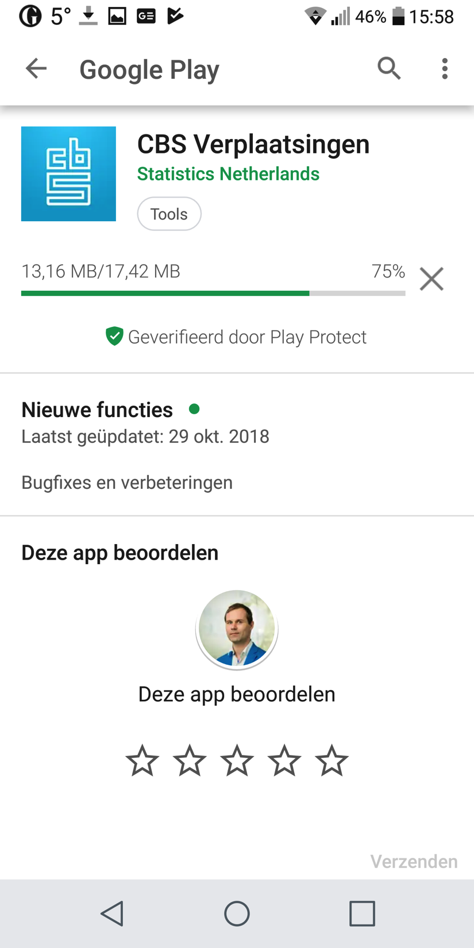
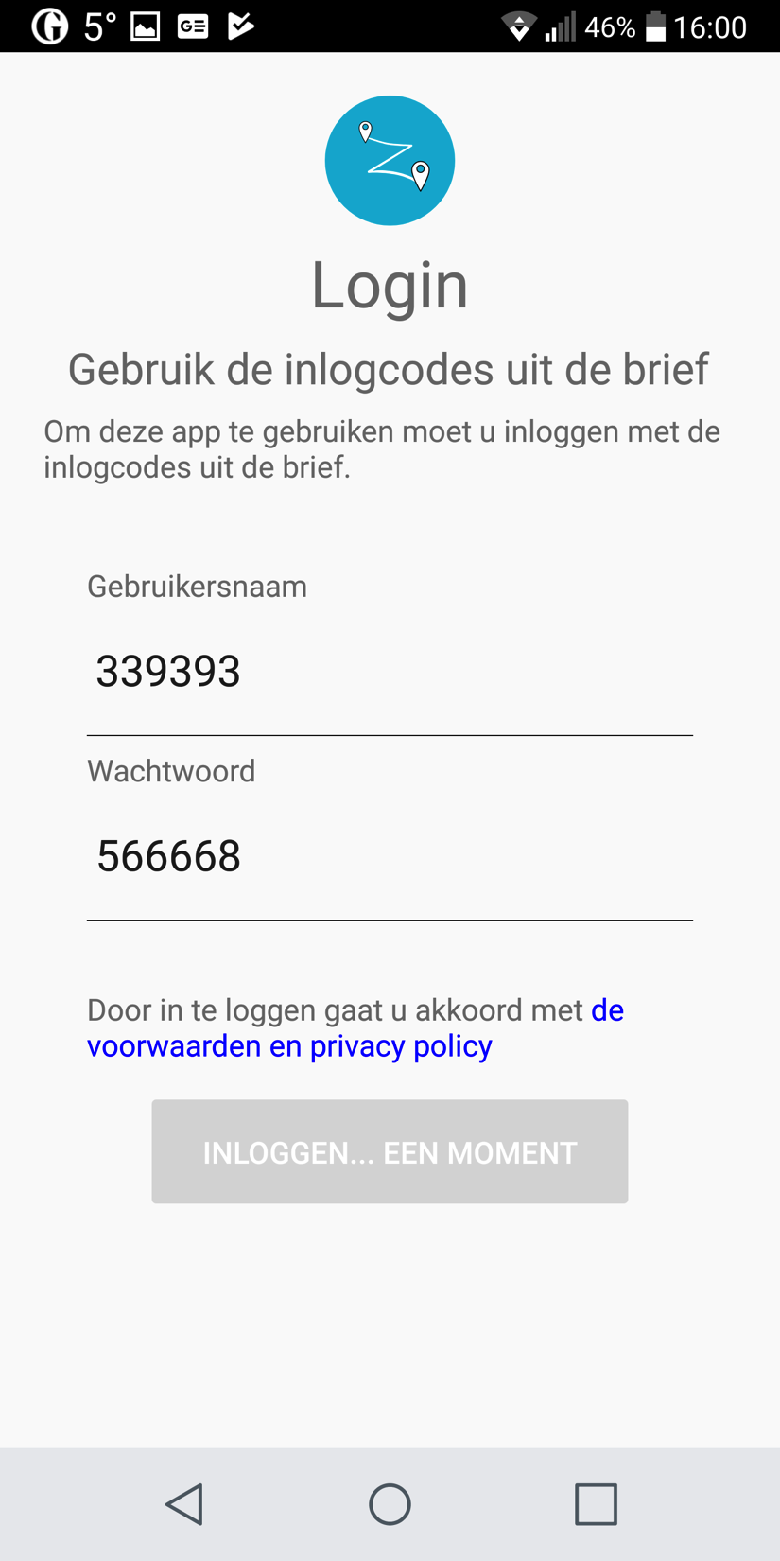
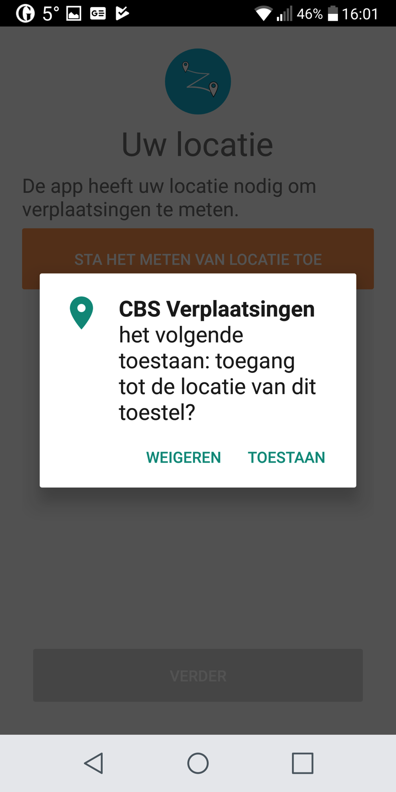
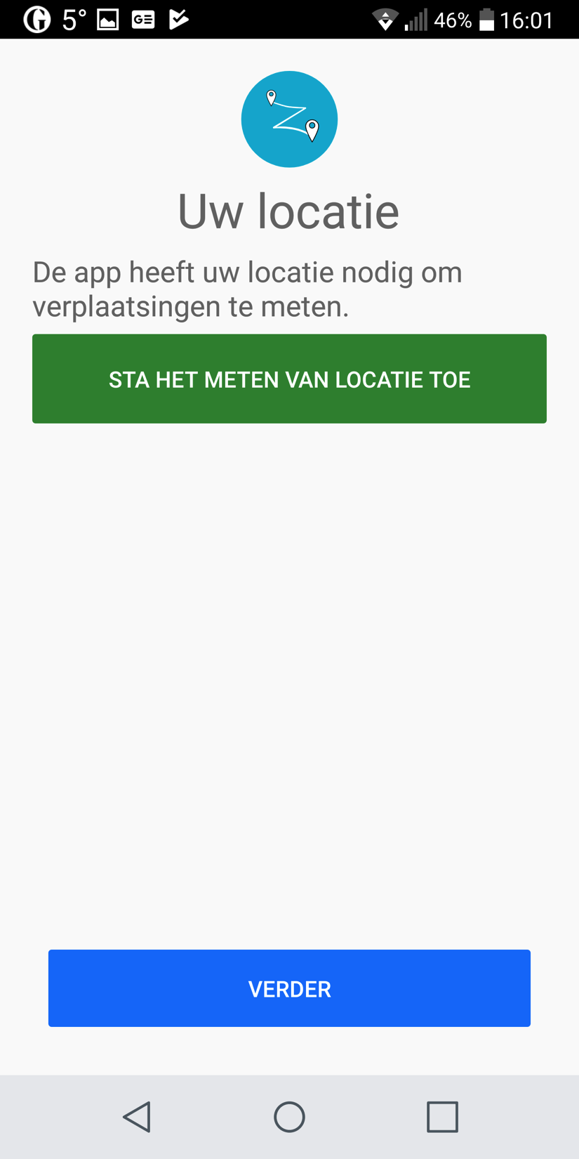
Recruitment (Lugtig et al. 2019)
Invitation letter
Website
App Download
Allow tracking
Google play store
Log in with credentials
Allow GPS tracking
Ready to use
Notes:
Can be implemented in browser and in app. Here an example of browser consent

Slide 53
Recruitment (Lugtig et al. 2019)
Fresh respondents
N=951
Web diary respondents
N=951
RR: 26.5%
RR: 44.4%
Download + Login
N=674
dropout: 17%
Send data for at least 1 day
N=578
dropout: 28%
Complete whole study
N=421

Slide 54
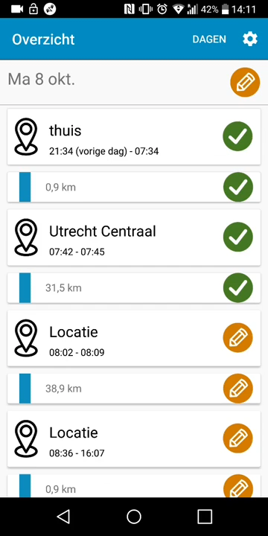
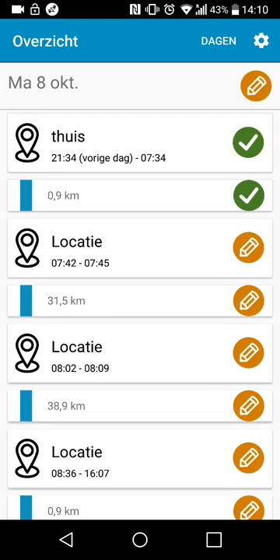
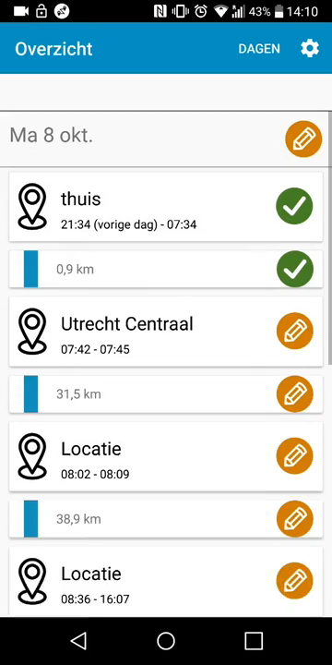
How do people move around in everyday life? (McCool, Lugtig, and Schouten, 2021)
Daily overview
Questions about stops
Questions about trips
Notes:
Stops and trips are detected on device (we will come back to it later in detail) because the respondent needs to answer questions about stops and trips

Slide 55
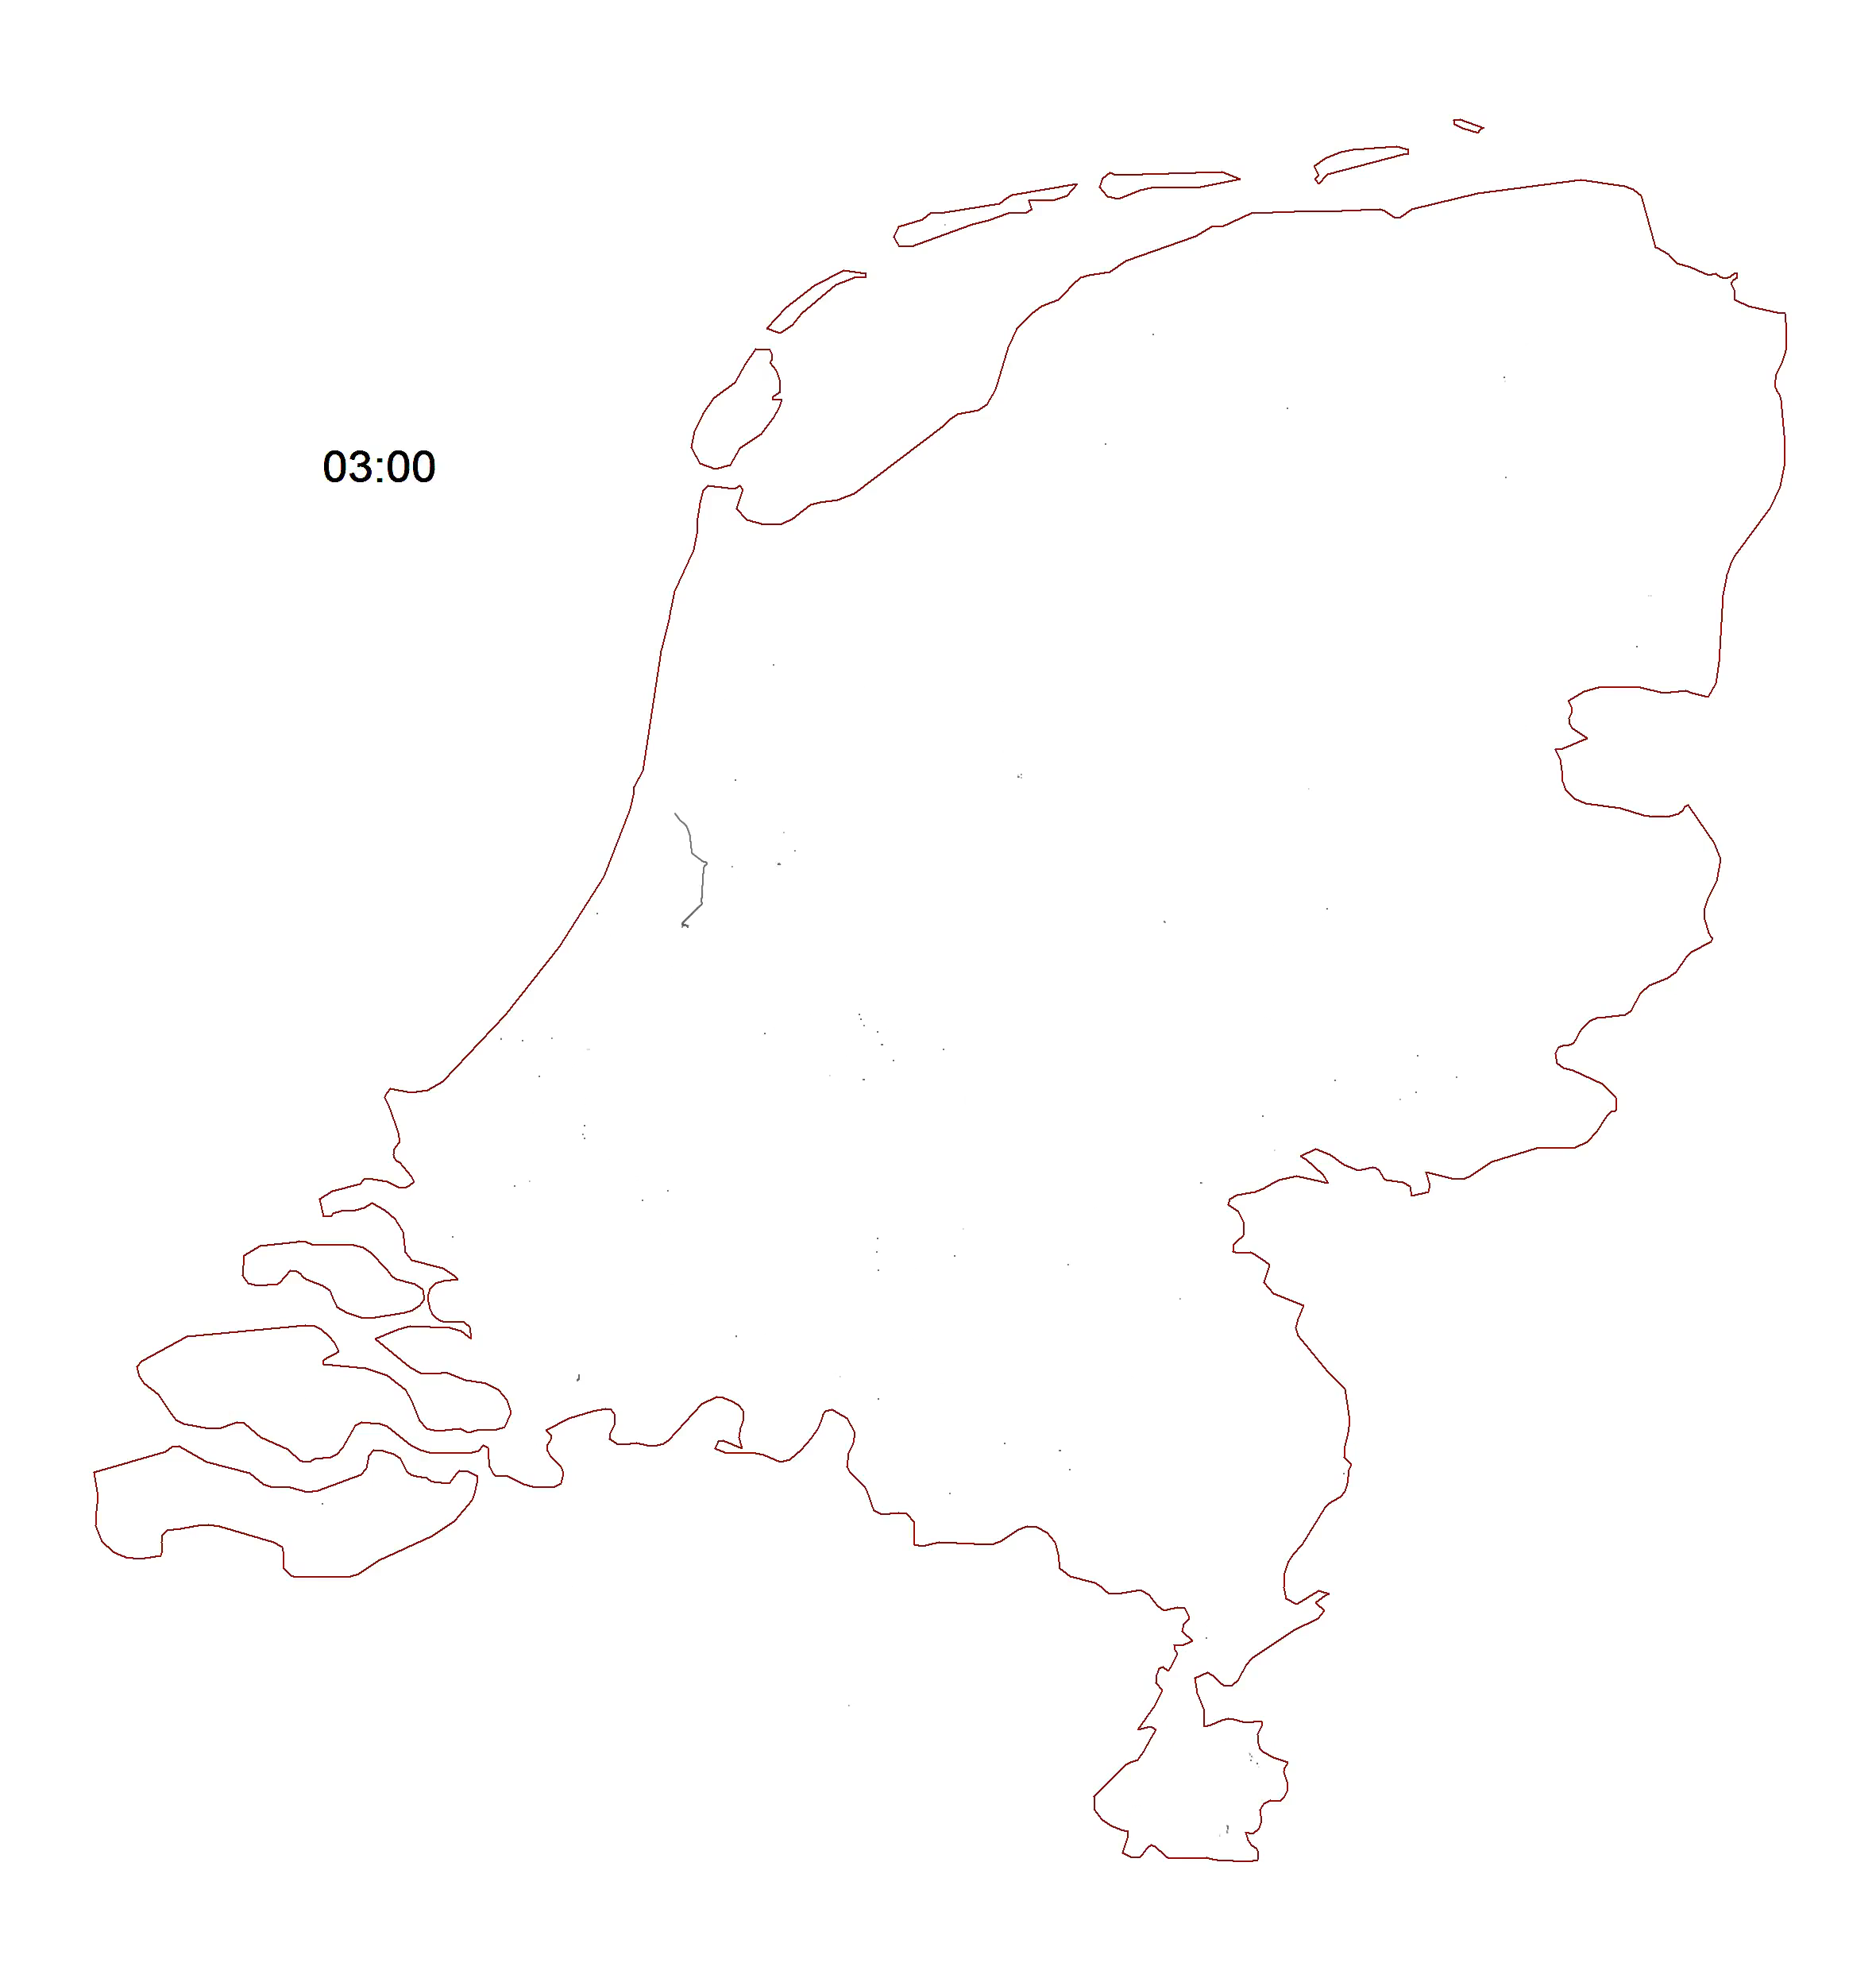
How do people move around in everyday life? (McCool, Lugtig, and Schouten, 2021)
One week travel
Notes:
Participants asked to label motives & means of transportation

Slide 56
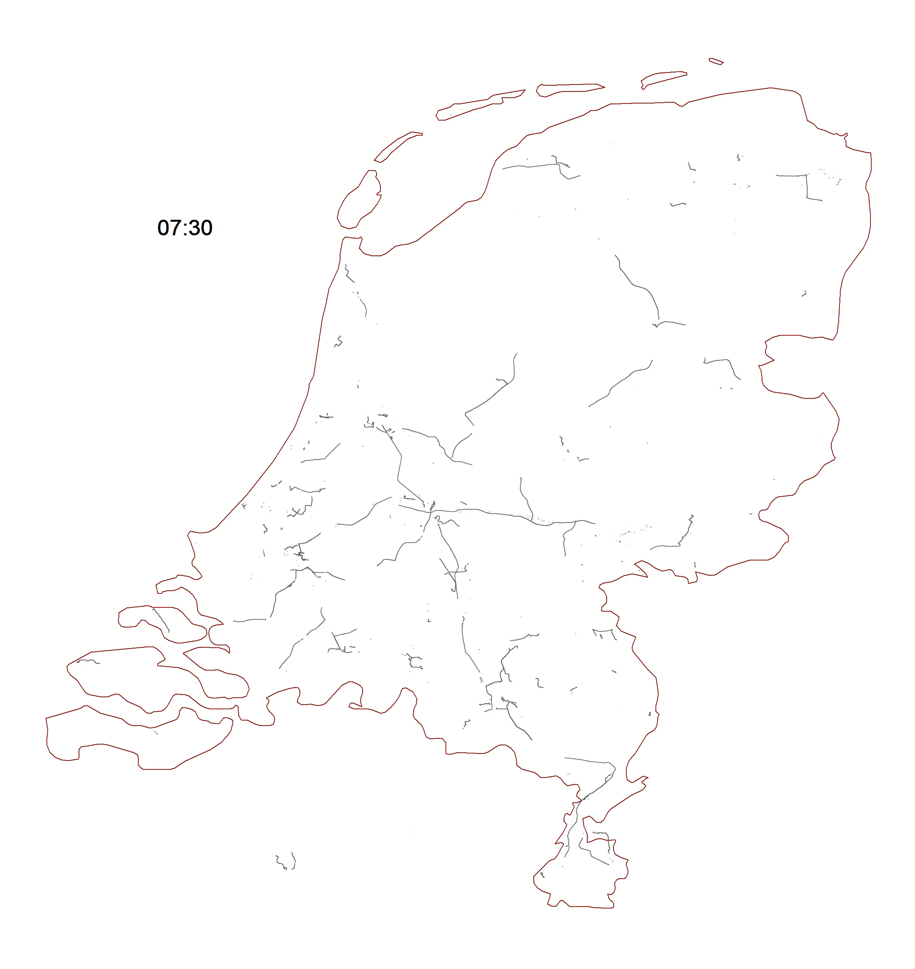

Slide 57
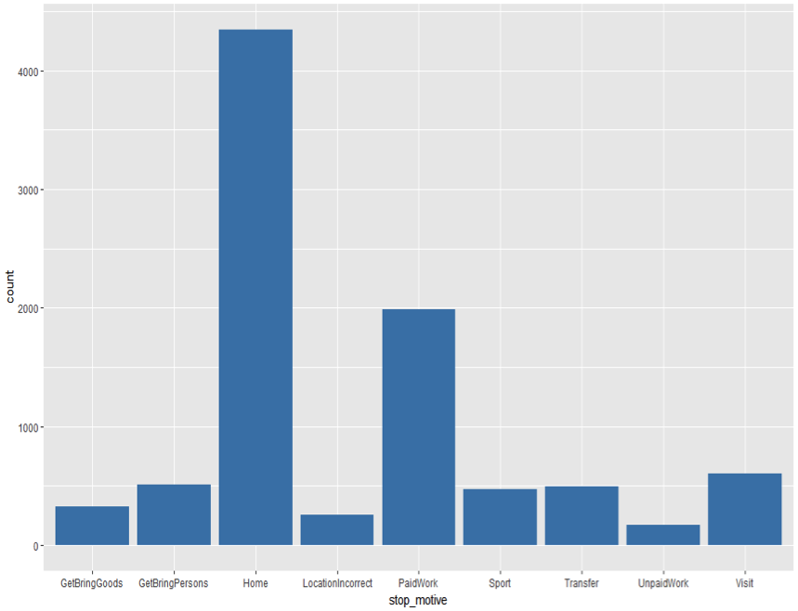
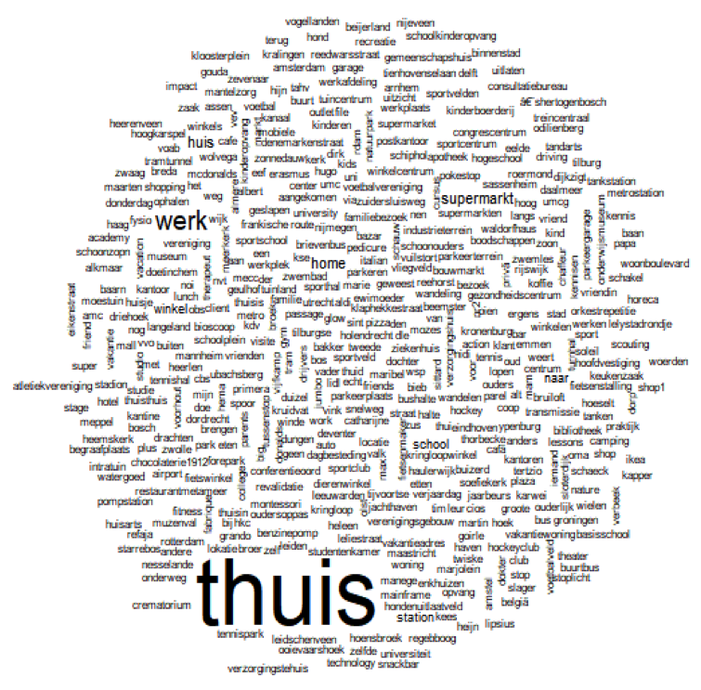
How do people move around in everyday life? (McCool, Lugtig, and Schouten, 2021)
22,000 stops
13,000 (60%) labeled
Overall 50% of respondents give complete/almost complete details
Notes:
Participants asked to label motives & means of transportation

Slide 58
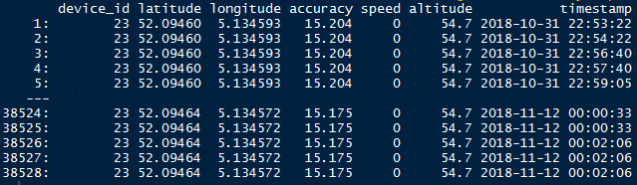
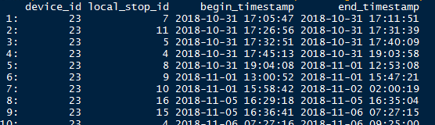
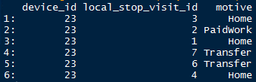
Raw data
Notes:
Tabi App data from a researcher; time stamps and locations
Stops identified by app and labeled by users
Stop detection parameters: 40-80 meters distance (by meter) from all other points & 2-6 min (by minute), e.g. one respondent has parameters 43 meters and 3 min, another respondent has 79 m and 5 min
Accuracy: a 68%-confidence interval, is from Google Geolocation API (in meters, radius of a given estimated location in meters) [We define horizontal accuracy as the radius of 68% confidence. In other words, if you draw a circle centered at this location's latitude and longitude, and with a radius equal to the accuracy, then there is a 68% probability that the true location is inside the circle. https://developer.android.com/reference/android/location/Location.html#getAccuracy()]
Local stop id is supposed to identify a stop but there was a bug in the app (so don’t focus on it much:))
Local stop visit id if a person has been to the stop already which visit it is

Slide 59
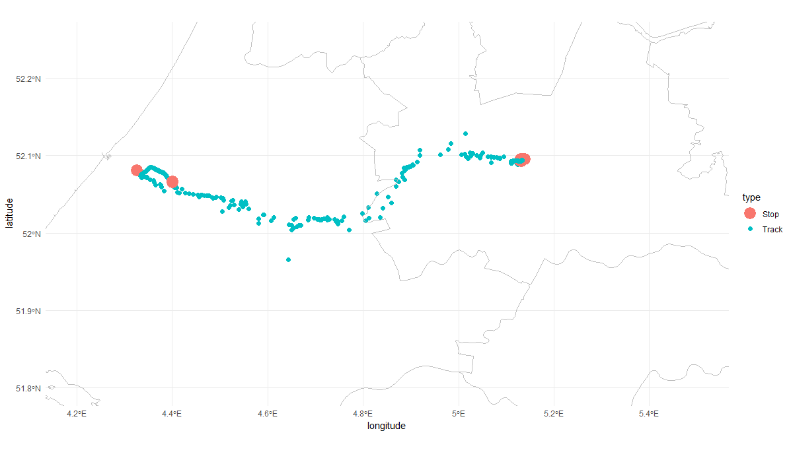
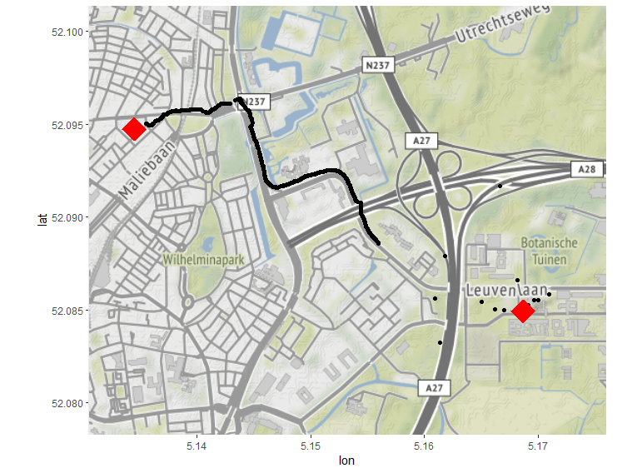
Making inference from raw data
Source: McCool et al. (2019)
Notes:
Researcher determines what a stop is (e.g., radius of no movement in specific time frame)

Slide 60
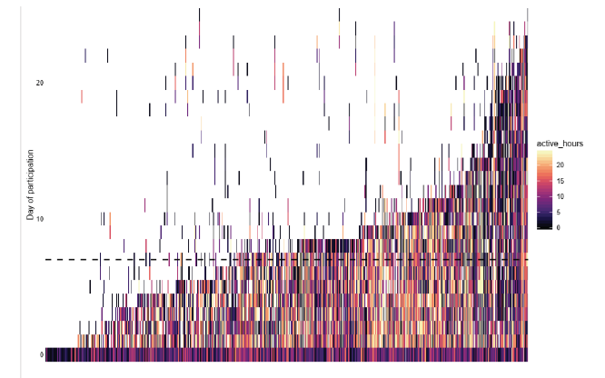
Errors during data collection & Missing data
Sensor-based errors
Missing data
Technical issues: e.g.,
Phone out of power or sleep mode
iOS blocks collection of location in background
Noncompliance: e.g.,
Missing permissions
Mobile data disabled
Leaving phone at home
Turning app off at certain locations
Erroneous data
Providing feedback & measurement reactivity
Active hours per user (McCool et al. 2019)

Slide 61
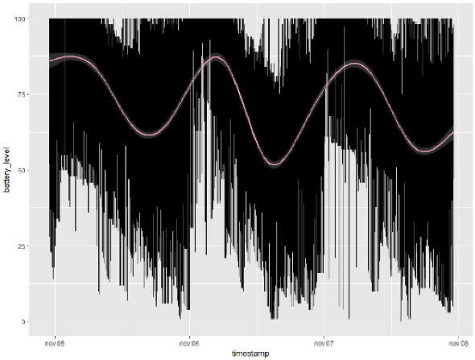
Battery life example: CBS Travel App (McCool et al.)
Battery levels for all participants Nov 5-8, 2018
Battery levels follow circadian pattern
Very few batteries run empty over course of four days
Notes:
don’t know whether they additionally charge but it’s not a problem for the study

Slide 62
Storage & Costs
One person’s GPS coordinates collected every second/min for 7 days would result in on average 60.000 data points per person
Think whether you really need this amount of data!
Most systems store data first on device and transmit them to server once connected to Wi-Fi
Processing data on device and only transmitting aggregated data saves storage space
Besides storage, costs can include:
App/In-browser measurement development
Incentives
Data handling
Helpdesk

Slide 63
McCool
Integration within study
(Source: Kreuter 2018)
Notes:
Data are generated incidentally or purposively
Transactional: credit card data, GPS location
Aspirational: tweets or facebook status

Slide 64






Picture project (Ilic et al 2022)
Note: pictures recreated, not actual pictures submitted by respondents
2700 LISS respondents on their mobile phone
1759 respondents
Asking for sensor measurements in context
Photo of favorite place
Photo of garden
Photo of heating elements
October 2019

Slide 65
Experiment with information
1. Pictures:
Would you be willing to take a picture of your favorite place/garden/heating system? Yes/no
Are you willing to share this picture?
2. Text:
Can you describe your favorite place/garden/heating system?
3. choice:
Would you rather take a picture or provide text answers in this study?

Slide 66
Questions
Willingness? What happens in choice-condition?
Quality of measurements
focus here on heating system
What provides better data? Text, pictures, or choice?
Analyses are results from thesis work of Goran Ilic

Slide 67
Choice does not lead to lower willingness
Of those who had a choice, about 57% opted for photos
And then ~80% took a picture
Experimental Condition | Fav. place | Outdoors | Heating
Picture condition: Took a photo | 43% (540) | 29% (521) | 36% (444)
Text condition: Answered the question | 98% (655) | 99% (632) | 67% (549)
Choice: picture & took photo | 48% (564) | 31% (537) | 37% (479)
Note: eligible n in parentheses

Slide 68
Quality of picture data (heating)
 | Sample size
Eligible for picture | 720
Submitted a picture | 321 (45%)
No Privacy issues with pics | 309
In line with task | 281 (88%)
Info at picture:
“good” quality (using OCR) | 212
Partly usable | 67
unusable | 2
Extract good info (brand+type) | 142 (44% of pictures, 20% overall)
+ only brand | 243 (76% of pictures, 34% overall)

Slide 69
Quality of text data (heating)
 | Sample size
Eligible for text | 953
Provided text | 489
- Uninformative | 104
- Brand + type | 142 (29% of texts, 15% overall)
- Only brand | 243 (50% of texts, 25% overall)

Slide 70
Conclusions (pictures)
Choice does not affect willingness for pictures
If anything, increases willingness
People more willing to provide text answers
But answers of lower quality than pictures
To do:
Selection bias?
Measurement now quantified as good/bad

Slide 71
Ilic et al (2022)
Alternative sources of data
Focus on quality
(Source: Kreuter 2018)
Notes:
Data are generated incidentally or purposively
Transactional: credit card data, GPS location
Aspirational: tweets or facebook status

Slide 72
What are the effects of unemployment? (Kreuter et al. 2018)
650 Android owners from German panel study “Labour Market and Social Security” (PASS) downloaded IAB-SMART app for 6 months
EMA questions concerning both subjective (e.g., affective impact of daily smartphone use, Big 5 personality) and objective phenomena (e.g., employment and job search activities, use of smartphones in everyday life, memberships in professional and voluntary organizations)
Five sensing modules:
Location using GPS, Wi-Fi, and cellular sensors every 30 minutes
Activity and means of transportation (e.g., walking, biking, riding in/on a motorized vehicle) using accelerometer and pedometer
Call and texting behavior using phone and SMS logs
Use of apps installed on smartphone
Social network characteristics from contact lists.

Slide 73

What are the effects of unemployment? (Kreuter et al. 2018)
Notes:
Unemployed start their day later but then they become quite active
Step count and walking speed do not differ

Slide 74
Practical implementation

Slide 75
Practical implementation:
Representation: is the population covered?
Nonparticipation:
Privacy & Consent
Measurement:
Frequency / sampling rate
Errors / missing data / battery life
Storage & Costs

Slide 76

Representation: Coverage
In Europe, mobile Internet access varies between 31% (Italy) and 84% (Netherlands, Sweden) in 2017 (Eurostat 2018)
Comparable numbers for Asian-Pacific area (eMarketer Report 2017)
Levels in Africa substantially lower with much variability across countries (Afrobarometer 2018)
Picture source:https://www.pewinternet.org/fact-sheet/mobile/

Slide 77
Representation: Coverage bias in Germany (Keusch et al. under review)
Absolute bias in many substantive measures of PASS for smartphone ownership relatively small (< +/-6 p.p.)
Especially once controlling for age (+/-2 p.p.)
Operating System (OS) Bias:
Android smartphone coverage bias generally not much higher than general smartphone coverage bias
Large iPhone coverage bias (up to +/-14 p.p.), even when controlling for age (up to +/-12 p.p., especially for measures of satisfaction and deprivation)
Source: PASS Wave 11; n = 13,703

Slide 78
2. (Non)participation: Willingness to participate (WTP) & actual consent
Small-scale studies relying on enthusiasts: Willingness = 100%
e.g., Wang et al. (2014), Fritz et al. (2017), York Cornwell & Cagney (2017)
Non-probability online access panels: Willingness between 5% and 56%
Varies across countries and by sensor type: 25%-52% for taking pictures, 19-37% for sharing GPS location (Revilla et al. 2016)
Probability-based panels:
LISS Panel: Mobility (GPS, accelerometer) 37% willing, 81% participated; Physical activity (wearables) 57% willing, 90% participated (Scherpenzeel 2017)
UK Understanding Society Innovation Panel: Download budget app 17% (Jäckle et al. 2019)
German PASS Panel: Download IAB-SMART app 16% (Kreuter et al. 2018)
Cross-sectional general population studies:
CBS Travel App Download & Registration: 35% (McCool et al. 2019)
WTP varies from 12% for photo of house to 67% for GPS (Struminskaya et al. 2018)
Notes:
Bella

Slide 79

2. Mechanisms of (non-)participation: Concern
Privacy/security concerns: higher privacy concerns correlate with lower WTP (Keusch et al. 2020; Revilla et al. 2018; Struminskaya et al. 2018; Wenz et al. 2019)
Source: Keusch, Struminskaya, Kreuter, Weichbold (i2020)
Notes:
Why do people participate and not participate
One of the main reasons is privacy concerns (compared to other data collection methods)
Passive data collection more concern, curation (I can see what I send to researchers)

Slide 80

Concern by Number of Smartphone Activities
Source: Keusch, Struminskaya, Kreuter, Weichbold (i2020)

Slide 81
No Effect of Emphasizing Privacy
“The data you provide will be treated confidentially. It will only be available to researchers conducting this study and your personal information will not be shared with third parties. The results of the survey will only be made available in the anonymized form. Your data is safe in all of our surveys. From the statistical information by CBS personal information can never be inferred.”
No significant differences
n=1883, Dutch smartphone & tablet users
Struminskaya et al. (2018)

Slide 82
2. Mechanisms of (non-)participation: Incentives
Inconsistent findings
Keusch et al. (2019):
Incentives for app download and staying until end of study increase hypothetical WTP
Haas et al. (2000): IAB-SMART, Germany
20€ for installation increase installation rate over 10€ (16% vs. 13%)
Bonus incentive for consenting to all 5 passive data collection functions has no effect
McCool et al. (in preparation): CBS Travel App, The Netherlands
Bonus incentive for staying until end of field period increase participation: 5€ Prepaid (voucher) +
+ 5€ Registration + 5€ at the end: 30%
+ 10€ at the end: 36%
+ 20€ at the end: 40%
Jäckle et al. (2019): IP Spending Study, UK
6£ incentive for installation does not increase installation rate over 2£

Slide 83
2. Mechanisms of (non)participation: Privacy & consent
Participants might have concerns about potential risks related to sensor data
Data streams could be intercepted by unauthorized party
Connecting multiple streams of data could re-identify previously anonymous users
Information could be used to impact credit, employment, or insurability
Collecting GDPR-conforming consent
Processing raw data on device
Collecting data at lowest frequency necessary to answer research question
Notes:
We need to think how to preserve privacy and inform participants fully about what will be collected, that people can revoke permission to collect data. To protect privacy one can process on the device (we have heard the microphone example Wang et al.) not recording actual conversations but whether there is a conversation

Slide 84



2. Example for consent: In-browser GPS (Struminskaya et al. 2018)
General consent
Framing, control, and privacy explanation
GPS measurement
Notes:
Can be implemented in browser and in app. Here an example of browser consent

Slide 85



2. Example for consent: In-browser camera (Struminskaya et al. 2018)
Video of surroundings
Selfie
Photo/video
Notes:
Can be implemented in browser and in app. Here an example of browser consent

Slide 86




2. Example for consent: IAB-SMART (Kreuter et al. 2018)
Individual consent screen
Function explanation
Full consent
App home screen

Slide 87


2. Example for consent: IAB-SMART (Kreuter et al. 2018)

Slide 88




2. Example for consent: IAB-SMART (Kreuter et al. 2018)
App settings
App settings
Withdrawing consent
Withdrawing consent

Slide 89
3. Frequency of measurement - Sampling rate
Situational
Discrete
Continuous
Combination

Slide 90
3. Frequency of measurement - Sampling rate
Situational
Measurement only at specific times
e.g., GPS location whenever EMA is answered (MacKerron & Mourato 2013)
Discrete
Usually to conserve battery and storage and/or to protect privacy
In case of GPS, allows to calculate activity radius but not specific traces
e.g., GPS every 5 min (York Cornwell & Cagney 2017) from 9 am to 9 pm, every 30 minutes (Kreuter et al. 2018)
Struminskaya & Keusch 2019

Slide 91
3. Frequency of measurement - Sampling rate
Continuous
Tracking of smartphone-mediated behavior usually always on (e.g., Kreuter et al. 2018; Sugie 2018)
GPS collected at high frequency allows measurement of exact route
e.g., every sec when moving, every min when still (McCool et al.)
Microphone always on (e.g., Wang et al. 2014)
But data processed on device to save storage and preserve privacy
Combination
e.g., measure activity (accelerometer) for 15 min twice a day (Lathia et al. 2017)
Struminskaya & Keusch 2019

Slide 92
Class exercise: Design a sensor & survey study

Slide 93
In groups: choose a RQ and suggest study design 20 min (design) + 5 (present)
What kind of sensor data should be collected and how would you collect these (be specific)
What kind of survey data should be collected and how would you collect these (be specific)
What kind of auxiliary data could be used?
Implementation (sampling rate, loan devices, ESM, etc.)
Added value (can you answer these questions with survey data?)
Discuss the design from the TSE perspective (focus on measurement, representation, or both)
RQ1: How do local environmental conditions affect the health of elderly residents in a large megapolis?
RQ2: How social ties develop in college students over time?
RQ3: How do people living in households spend money?
RQ4: How do behaviors of employed and unemployed persons differ?

Slide 94


Take home exercise
If you have an iPhone or an Apple watch (or your friend with an iPhone graciously shares data with you or you google how to replicate it for android)
Download your apple health data, prepare it for analysis and find out something about yourself (see next slide)

Slide 95

Take home exercise
Go to “Health” -> click on profile -> Download All Health Data
Follow the steps from here to prepare for analysis: https://taraskaduk.com/posts/2019-03-23-apple-health/
You will need these packages and use only if you want to change time zones, otherwise comment out
#endDate = ymd_hms(endDate,tz="America/New_York"),
Find out about something about yourself! e.g., your average step count, how many steps you go by day of the week and when, or something more interesting
Send me your code and your result (e.g., a plot) and I will tell Peter ☺

Slide 96

Take home exercise
It is optional! So no stress…
*German “entspannen” = relax

Slide 97
Questions? Comments?
Now or contact me at b.struminskaya@uu.nl

Slide 98
References & Additional reading
Baker, Reginald P. 2017. Big Data: A Survey Research Perspective. In „Total Survey Error in Practice“, ed. by P. P. Biemer, E. De Leeuw, S. Eckman, B. Edwards, F. Kreuter, L. Lyberg, C. Tucker, and B. West, Hoboken, NJ: Wiley
Beyer, M. A., and D. Laney. 2012. The Importance of “Big Data”: A Definition. G00235055. Stamford, CT: Gartner.
Callegaro, M., and Yang, Y. 2017. The role of surveys in the era of „big data“. In „The Palgrave Handbook of Survey Research”, ed. by D.L. Vannette and J.A. Krosnick, Palgrave. doi: 10.1007/978- 3-319-54395-6_23
Groves, R. M. 2011. Three eras of survey research. Public Opinion Quarterly 75(5), 861-871. doi:10.1093/poq/nfr057
Ilic, G., Schouten, J.G., Lugtig, P., Mulder, J., Streefkerk, M., Kumar, and P. Höcük, S. (2022). Pictures instead of survey questions: An experimental investigation of the feasibility of using pictures in a housing survey. JRSS:A.
Lugtig, P., Roth, K., Schouten, J.G. (2022). Nonresponse analysis in a longitudinal smartphone-based travel study . Survey Research Methods, pp. 13-27.
McCool, D., Lugtig, P., Mussman, O. & Schouten, J.G. (2021). An app-assisted travel survey in official statistics. Possibilities and challenges. Journal of Official Statistics, vol. 37, 149-170.
Salganik, M. 2018. Bit by bit. Social research in the digital age. Princeton University Press.
Struminskaya, Lugtig, Keusch, Höhne (2020). Using mobile apps and sensors in surveys. Special issue of the Social Science Computer Review (contributions on SSCR website by English et al., Bähr et al., Sepulvado et al., Wenz et al.)
Struminskaya, B., Lugtig, P., Toepoel, Schouten, J.G., Giesen, D. and Dolmans, R. (2021). Sharing Data Collected with Smartphone Sensors: Willingness, Participation, and Nonparticipation Bias. Public Opinion Quarterly, advance access.

